Slide 1
Solving the Maze problem with ILP
Angelo Andreussi, Alex Della Schiava, Claudia Maußner

Slide 2
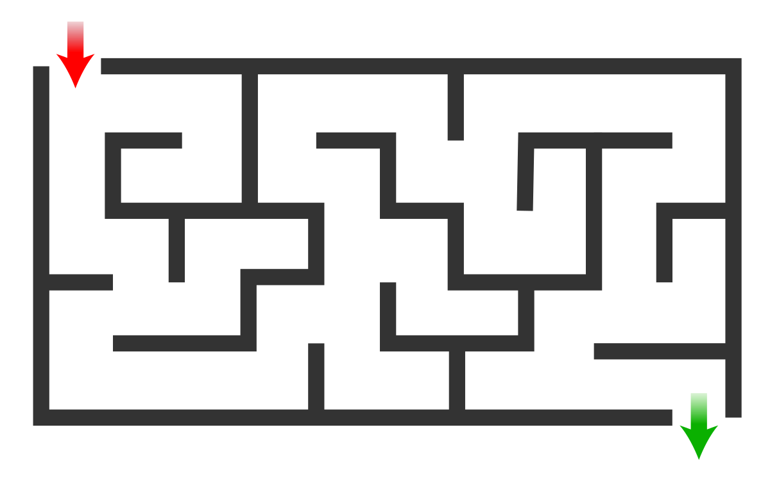
The Maze Problem
A fairly simple problem.
Find a path from point A to point B in a labyrinth-shaped map.
Can be solved with a huge variety of classical algorithms
An example of a Maze

Slide 3
Our tools
HYPER (Bratko, 1999): Based on Top-down search in the hypothesis space (Best-first search).
Metagol (Cropper, Muggleton, 2016): Based on meta-interpretative learning.
ILASP (Law, 2018): Inductive Logic Programming in the context of Answer Set Programs (ASP).

Slide 4
Our goals
Of course, solving the Maze problem.
In some cases, directly through ILP;
Otherwise, using the code learned through ILP.
Comparing HYPER, Metagol and ILASP.
Different systems produce different performances.
Not only, they can also lead to huge differences in the approach of the problem.
Further studying and analyzing these ILP techniques.

Slide 5
The maze
All three implementations use the same maze:
 |  | X=1 | X=2 | X=3 | X=4 | X=5
Y=1 |  | S
Y=2
Y=3
Y=4
Y=5 |  |  | G

Slide 6
ILASP
Actually, ilasp version 3

Slide 7
Brief recap on ASP
ASP model is (roughly speaking) a set of rules that represent logics of a problem. The solver tries to find all interpretations (atoms wich are true) that satisfies rules, namely the Answer sets.
An example for the maze problem: write set of rules that specify legal moves on the grid in a logical manner and find out all answer sets: different set of moves (paths) from start to goal position.
Different types of rules in an ASP encoding:
Normal rule :
h :- b1, . . . , bn | where h1 is an atom and b1 . . . bn are literals…semantic similar to prolog.
Hard constraint :
:- b1, . . . , bn | if b1 . . . bn are satisfied by an interpretation, then it cannot be an answer set.
Choice rule :
l{h1; . . . ; hm}u :- b1, . . . , bn | l, u integers. If the body is satisfied then between l and u of the atoms h1...hn are satisfied

Slide 8
ILASP
The Inductive learning tool used in ASP is Ilasp.
It enables learning programs containing normal rules, choice rules and hard constraints, specifying (as always) background knowledge, search space and examples.
Here it has been used for the maze problem, specifically to learn some normal rules that compose the ASP model wich solves the problem of path finding.

Slide 9

Learning to move on adjacent cells
Goal: Learn the move on adjacent cells, not considering for now the obstacles. (Predicate next/2).
Background Knowledge:
«succ» predicate, = predicate true for adjacent cells. «cell» predicate, = predicate true for coordinates on the grid.
Positive examples: shows that next is true for near cells on the grid /Negative examples: shows different contexts where next cannot be true; when 2 cells are distant, or when you exit from the grid, when cells are in the same diagonal.
mode bias: predicates «cell», «succ», and «next» on the head of the rules.
Parameters:
max_proof_length( 2).
max_clauses( 2).
max_clause_length( 3).

Slide 10
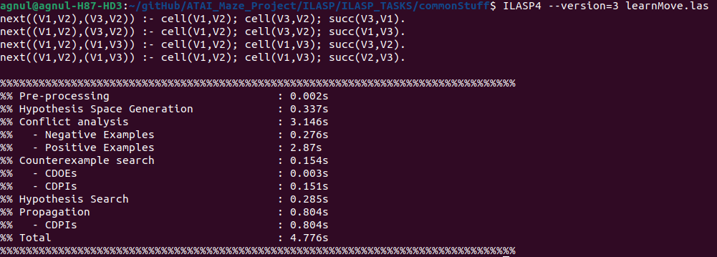
Output of ILASP task
(Vx, Vy) are coordinates on the grid

Slide 11
Learning to move on adjacent cells – considering obstacles
Goal: using what learned previosuly, learn to move into cells without obstacles (Predicate next/2).
Background Knowledge:
«succ» predicate, = predicate true for adjacent cells. «cell» predicate, = predicate true for coordinates on the grid.
Positive examples: shows that next is true for near cells on the grid /Negative examples: shows different contexts where next cannot be true; when 2 cells are distant, or when you exit from the grid, when cells are in the same diagonal.
mode bias: predicates «cell», «succ», and «next» on the head of the rules.
Parameters:
max_proof_length( 2).
max_clauses( 2).
max_clause_length( 3).

Slide 12
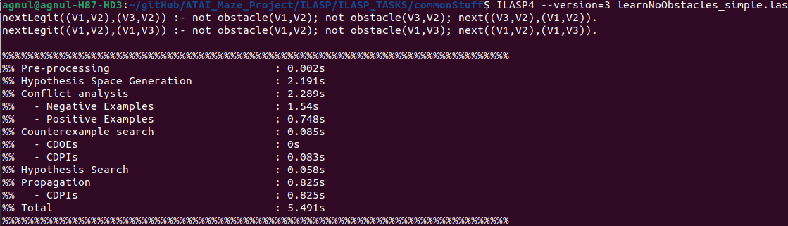
Output of ILASP task
(Vx, Vy) are coordinates on the grid

Slide 13
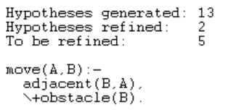
Learning to walk
Goal: Learn to move to an adjacent, legal cell (cell with no obstacle). (Predicate move/2).
Background Knowledge:
backliteral( obstacle(X), [X:cell], []).
backliteral( \+ (G), [X:cell], []) :-
G = obstacle(X).
backliteral( adjacent(X,Y), [X:cell,Y:cell], []).
Structured terms: none
Start Hypothesis: start_clause( [move(X,Y)] / [ X:cell, Y:cell] ).
Positive examples: 1 / Negative examples: 1
Parameters:
max_proof_length( 2).
max_clauses( 2).
max_clause_length( 3).
The number of hypotheses generated and refined is independent of the size of the grid and the grid!

Slide 14
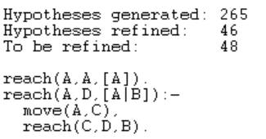
Learning to travel
Goal: Learn to move from two distant cells in the maze without going through illegal cells. (Predicate reach/3).
Background Knowledge:
backliteral( move(X,Y), [X:cell], [Y:cell]).
backliteral( reach(X,Y,L), [X:cell,L:list], [Y:cell]).
Structured terms:
term( list1, [X|L], [ X:cell, L:list]).
term( list1, [X], [X:cell]).
Start hypothesis: start_clause([ reach(X,Y,L)] / [X:cell,Y:cell,L:list1]).
Positive examples: 3 / Negative examples: 5
Parameters:
max_proof_length( 5).
max_clauses( 2).
max_clause_length( 3).

Slide 15
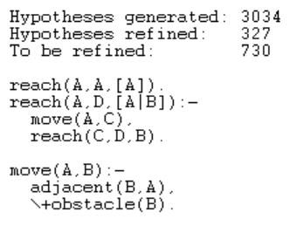
Combined Learning: walk & travel
Goal: Learn the two predicates move/2 and reach/3 at once.
Background Knowledge:
Same as before for both tasks
Structured terms:
Same as before for both tasks
Start hypothesis: Same as before for both tasks
start_clause( [move(X,Y)] / [ X:cell, Y:cell] ).
start_clause( [ reach(X,Y,L)] / [X:cell,Y:cell,L:list1] ).
Positive examples / Negative examples: same as before
Parameters: Changed!
max_proof_length( 7).
max_clauses( 4).
max_clause_length( 3).

Slide 16
Findings
Do not put too many examples! Start with 1- 2 examples and then add successively new ones as needed.
Do not forget about the parameter settings.
Start learning small steps / simple tasks.
It is more efficient to learn each action on its own then all at once (only one start_clause). With more than one start clause and many backliterals the task grows heavily.
Recursiveness simplifies the learning.

Slide 17
Performance comparison
Task | Hyper | Metagol | ILASP
adjacent | 175,884 s
move | 0,063 s
reach | 1,577 s
move & reach | 16,585 s
Mean values from 10 runs

